Slide 1
Success Rate Prediction for Crowd Funding
Instructor:
Christopher Asakiewicz
By,
Suguna Bhargavi Bontha
Sucharitha Batchu

Slide 2
Table of Content
Introduction
About the data
Modelling
Run Time Comparison Using Graphs
Results
Conclusion

Slide 3
INTRODUCTION

Slide 4
Background
Artists, musicians, filmmakers, designers, and other creators , everyone needs the right resources and support they need to make their ideas a reality.
Till date, tens of thousands of creative projects — big and small — have not been able to come to life because of a lack of support.
Kickstarter is a funding platform for all such creative projects. No one will be charged for a pledge towards a project unless it reaches its funding goal.
This way, creators always have the budget they scoped out before moving forward. Thus they help bring creative projects to life

Slide 5
Objective
We use the method of EDA (Exploratory Data Analysis) to analyze the data we cleaned
We step to the classification part, four classifiers are used to create data models. They are Logistic Regression, Decision Tree, Random Forest and Gradient Boost Tree.
The best fit model is determined. It determines if a project that is still in progress to be successful or not.
Analyzing this problem will be useful to both the users and people who are crowd sourcing. Users will be able modify their project based on factors influencing and funders will be able to make a decision on funding.
Algorithms are run both on local machine and cloud and the performance is compared.

Slide 6
PySpark
PySpark is the collaboration of Apache Spark and Python. It is a Python API for Spark that lets us harness the simplicity of Python and the power of Apache Spark in order to tame Big Data.
Similar to spark, it is an open source data processing framework for performing Big data analytics on distributed computing cluster.
The core data structure is RDD (Resilient Distributed Dataset).
Runs programs up to 100x faster than Hadoop MapReduce in memory, or 10x faster on disk.
We ran classifications in pyspark on both local machine and cloud using databricks.

Slide 7
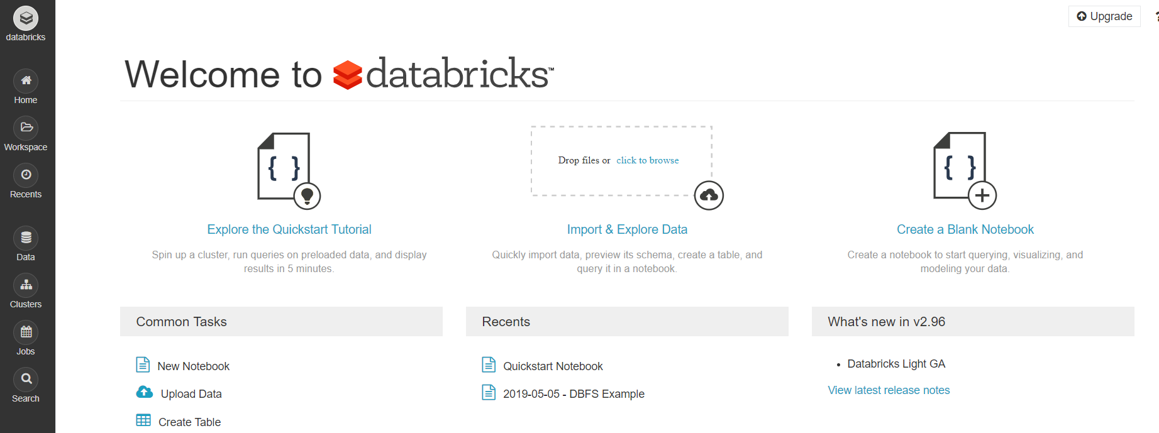
Cloud service used for the classifications.
Databricks
There are different options for running spark on cloud- Self Hosted, Cloud Providers, Vendor Solutions.
Databricks is a Vendor Solutions providing Company
It is easy to sign up and use.

Slide 8
ABOUT THE DATA

Slide 9
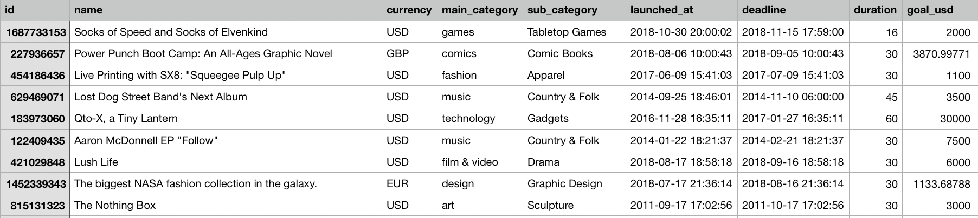
Data source and columns.
We obtained the dataset from Kaggle .
It is a csv file and contains around 200000 rows and 20 columns.
The columns are as shown:

Slide 10
Data Understanding
variables used for the classification are listed in next block
Duration, goal_usd, blurb_length, name_length, start_month, end_month, Category, Country, StartQ, EndQ and Status
Status is the dependent variabl

Slide 11
Data processing and preparation
Data Cleaning (remove N/A value)
Data normalization
Currency: We coded a function to convert all currencies to USD.
Time: The original time format in our data is in timestamp format. We change the time format to YYYY-MM-DD for easy calculating.
Re-category: In the original dataset, there are over 50 ‘loc_country’ and 145 ‘cate_name’. We categorize them into big categories based on scientific judgement.
Dummy value: Since the Country and category data is not numeric, we set them to dummy values.
Data Balancing (Oversampling is used)
Data standardization
PCA dimension reduction

Slide 12
MODELLING

Slide 13
Algorithms used
Logistic Regression
Decision Tree
RandomForest
GradientBoostTree

Slide 14
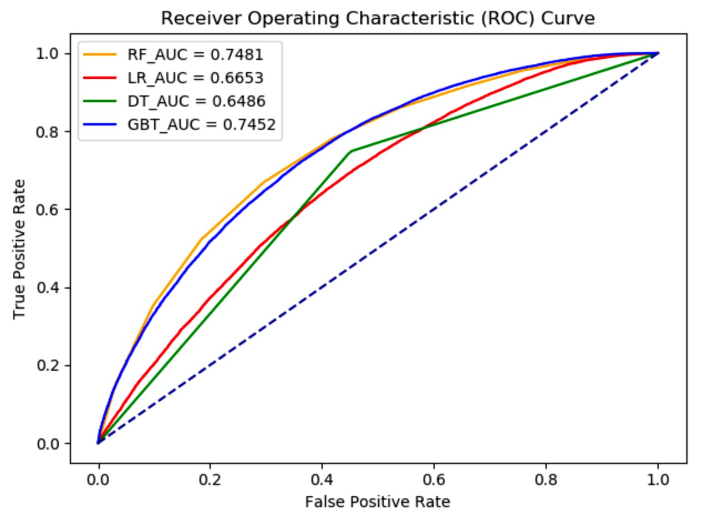
ROC Curve

Slide 15
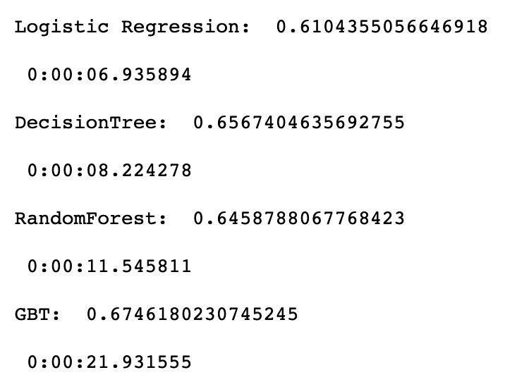
Efficiency and run time
On local machine

Slide 16
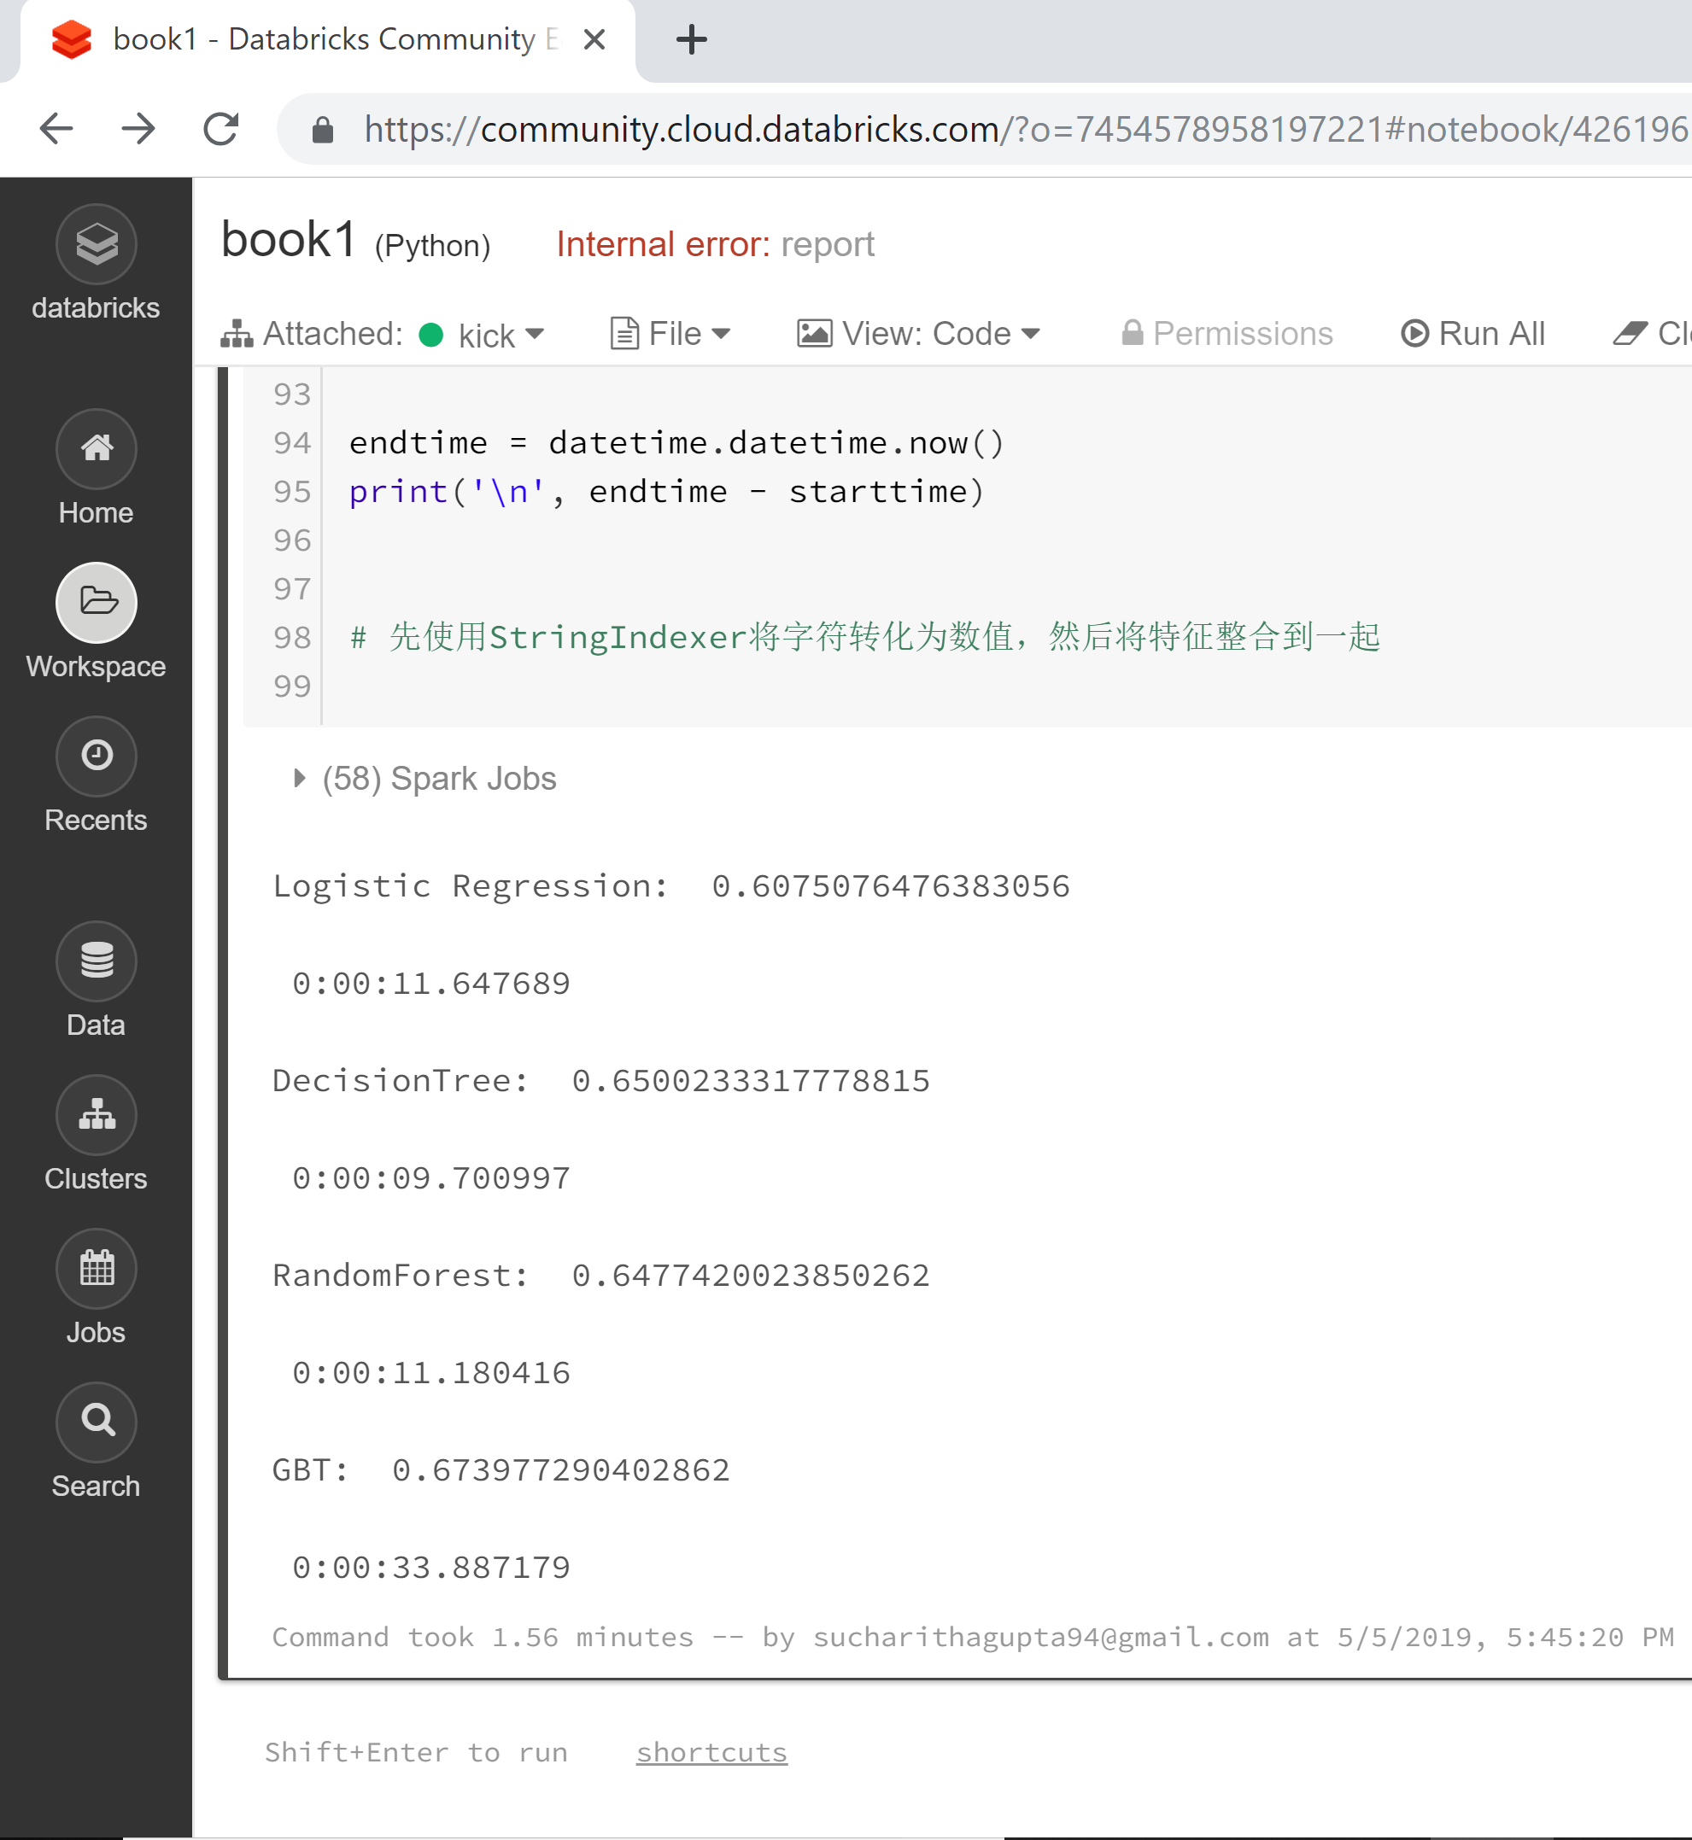
Efficiency and run time
On cloud service(databricks)

Slide 17
RUN TIME COMPARISION USING GRAPHS

Slide 18
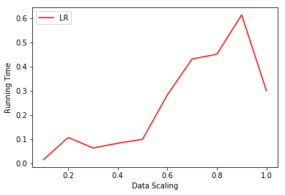
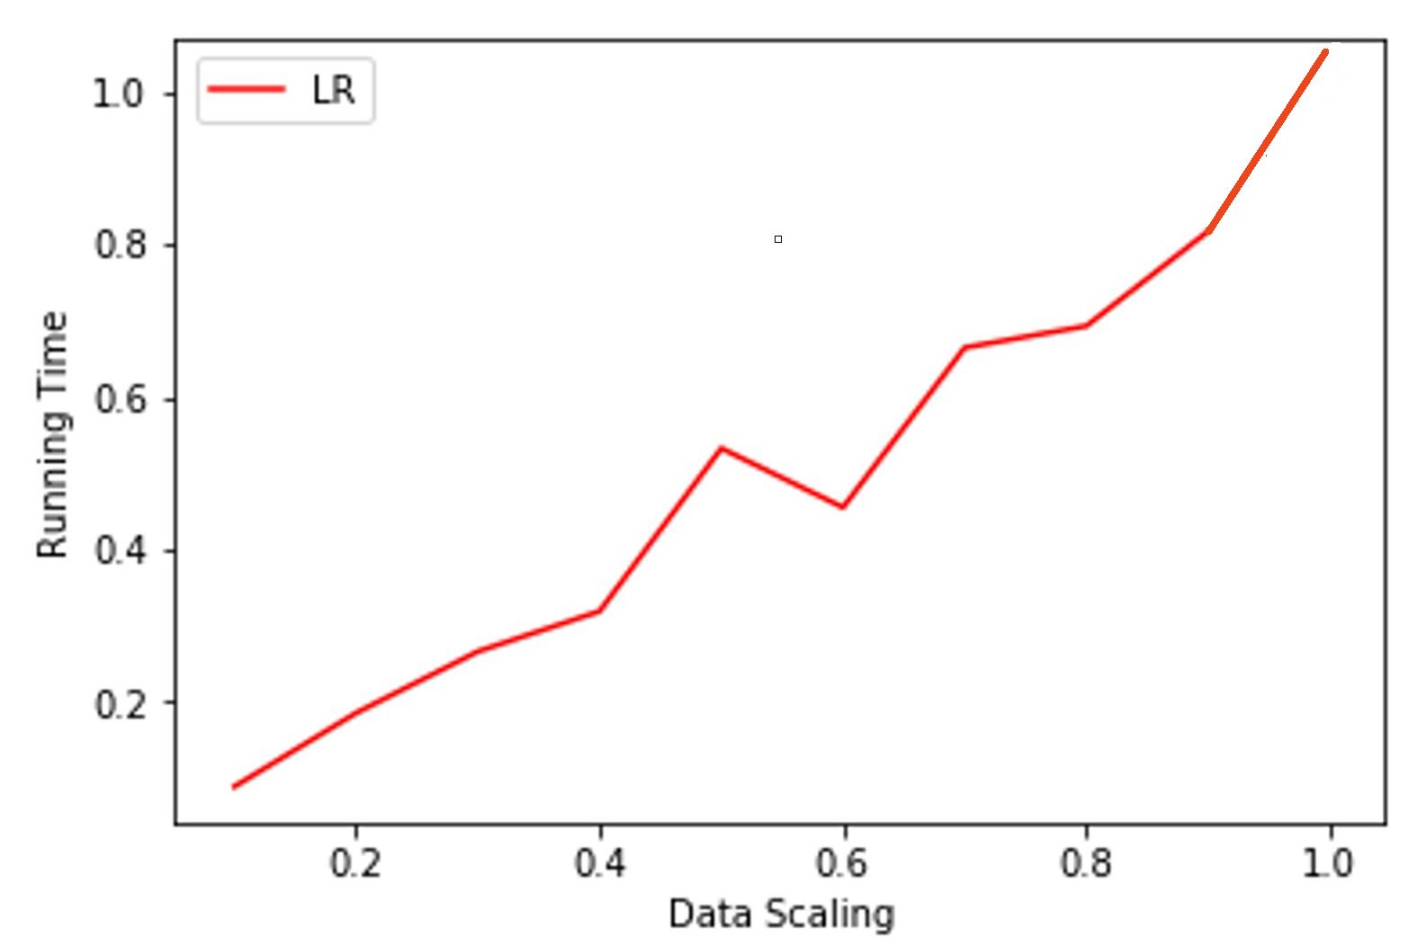
Logistic Regression
Local Machine
Cluster

Slide 19
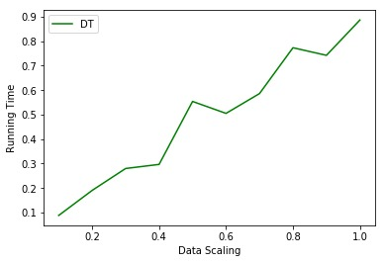
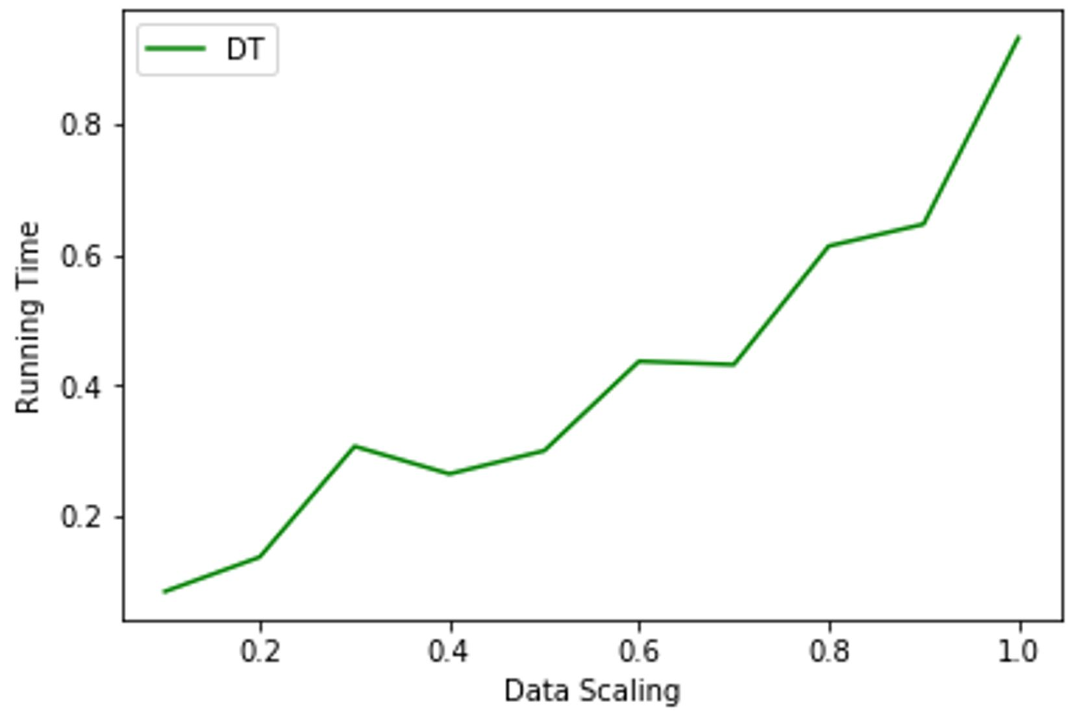
Decision Tree
Local Machine
Cluster

Slide 20
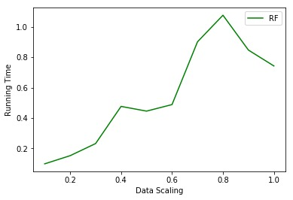
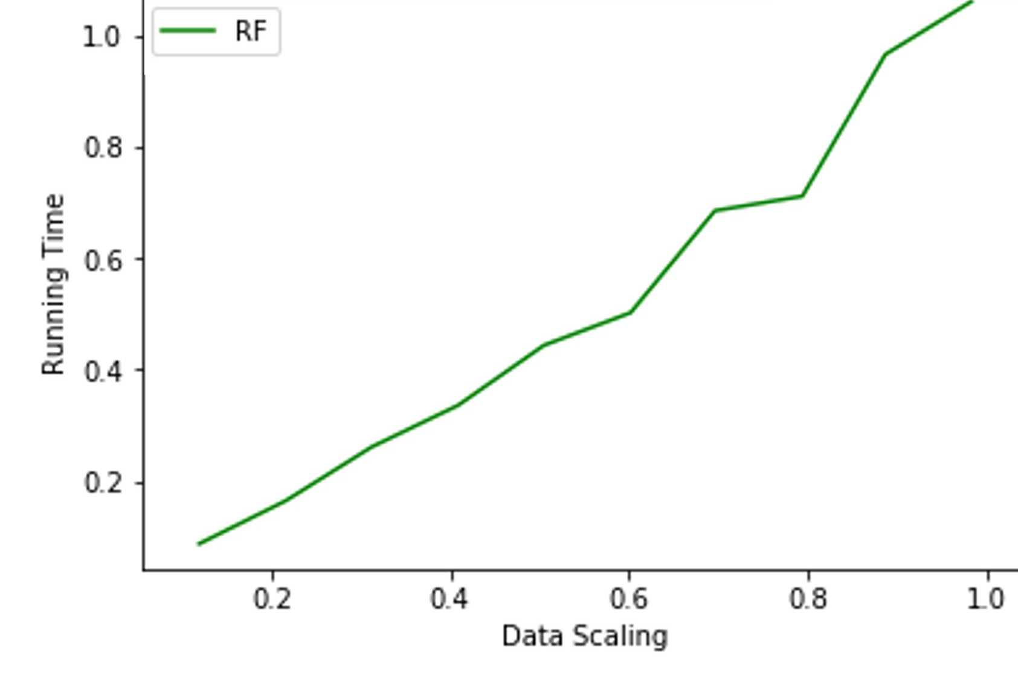
Random Forest
Local Machine
Cluster

Slide 21
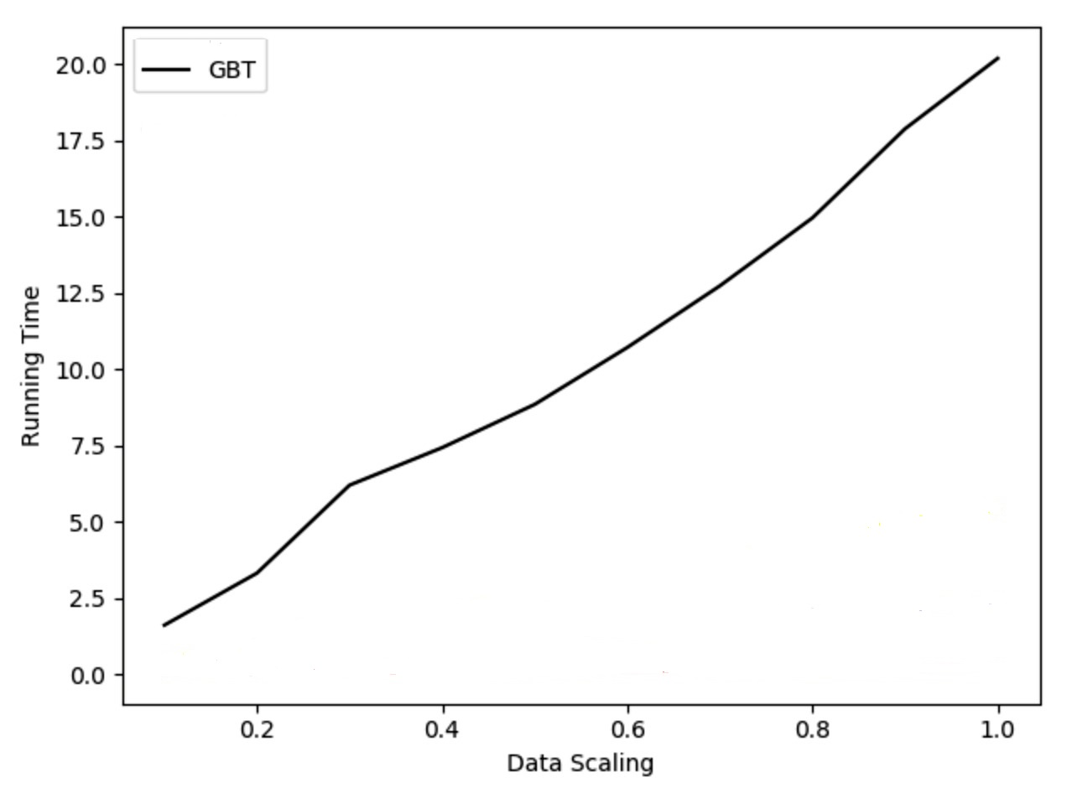
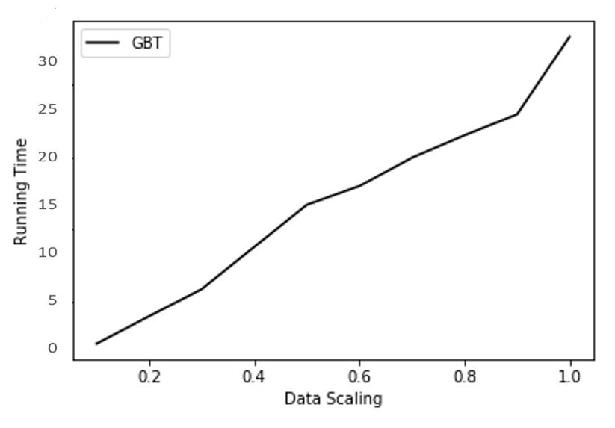
Gradient-Boost-Tree
Local Machine
Cluster

Slide 22
RESULTS

Slide 23
Models which have higher AUC take high computational time on both local and cluster
Gradient Boosting outperforms other models in AUC but takes maximum time as well
Random Forest has the right balance of computational time and AUC – It is robust across local machine and cluster
We observed more time taken on cloud .However we are assuming that Local Internet speed/Bandwidth can be a reason

Slide 24
CONCLUSION

Slide 25
Random Forest is the recommended model based on above analysis for success rate prediction for crowd funding
As scaling increases, the performance on cluster improves.
Thus we concluded that the models perform better on cluster vs the local if the data is big

Slide 26
THANK YOU!

